Slide 1
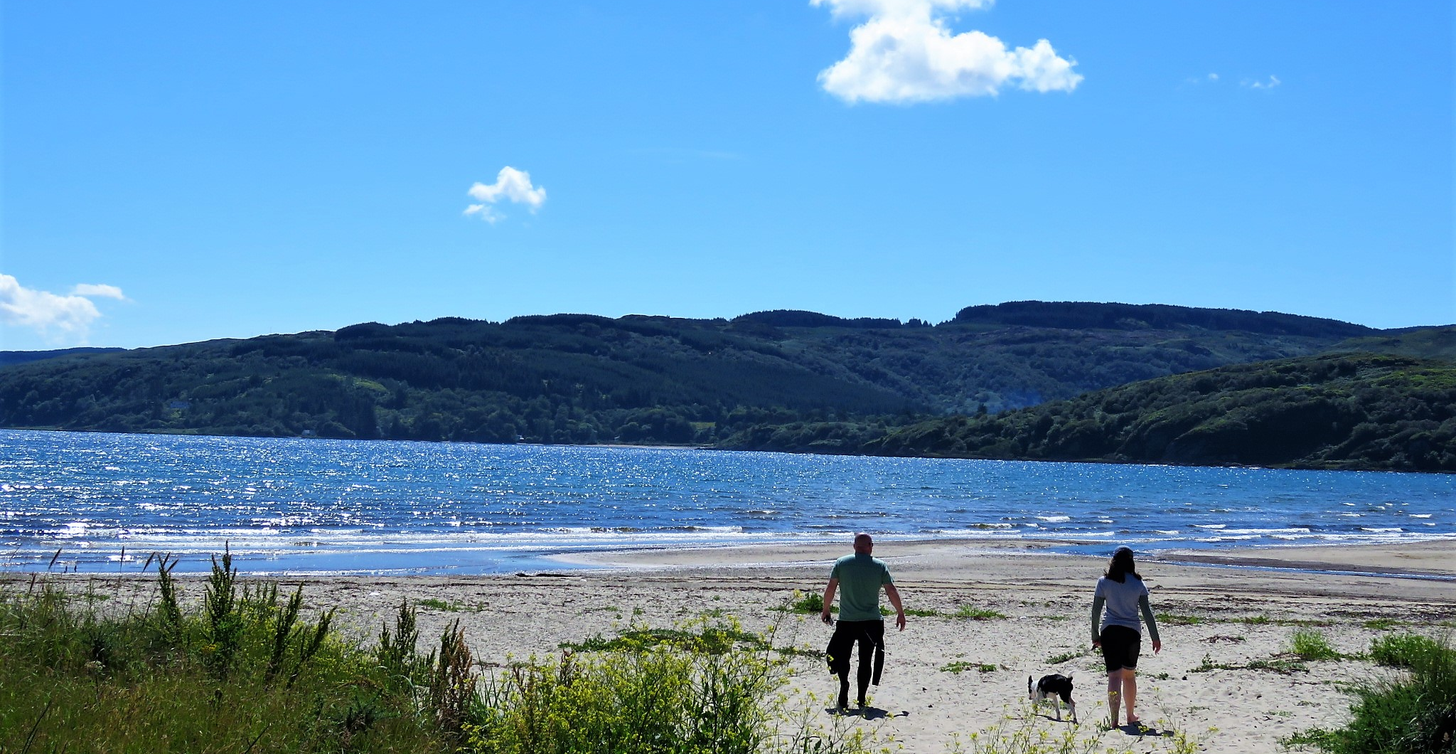
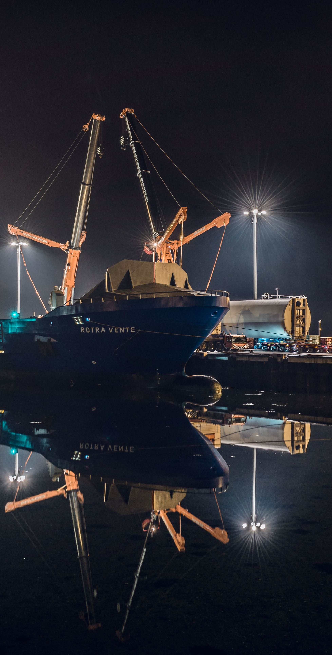
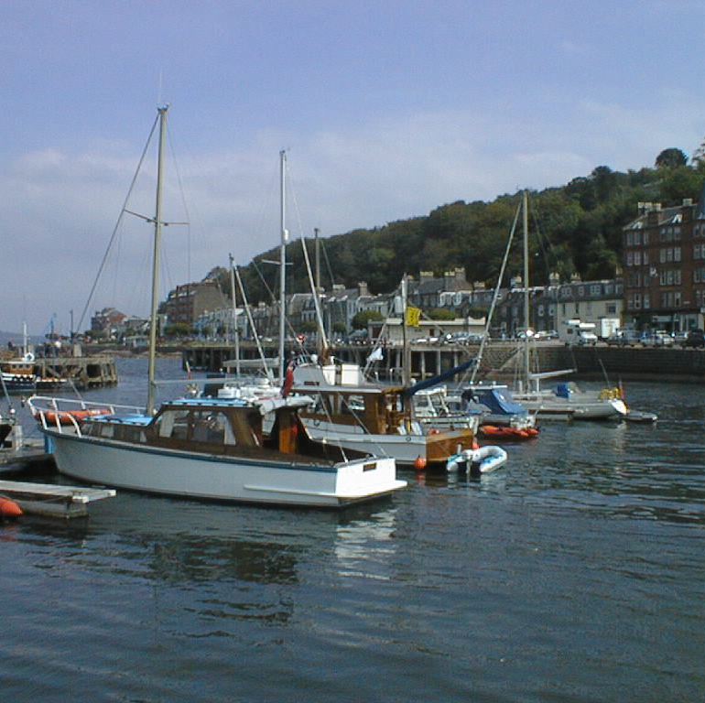

Transformation Update
Employee Joint Consultative Committee
15 February 2019
DOUGLAS HENDRY
EXECUTIVE DIRECTOR – CUSTOMER SERVICES

Slide 2
Areas of Focus for the Transformation Board in
2019 and beyond
The Transformation Board continues to oversee transformational change across the Council and have identified a number of longer term options that will be pursued during 2019 and beyond.
Renewables Investment
Digital Transformation
Further Rationalisation of face to face service provision
Further Office Rationalisation
Continuation of One Council Property Approach
Further Review of Loans Charges
Review Fees and Charges
Sustainable Education as part of the Northern Alliance

Slide 3
Areas of Focus for the Transformation Board in
2019 and beyond
  Renewables Investments
    Currently investigating the possibility of a wind turbine development in conjunction with Fyne Homes
  Digital Transformation
    11 digital transformation options commissioned in 2017 will be implemented by 31 March 2019.
    Further opportunities for digital progression are being investigated (most big ticket items which bring significant cashable savings have already been implemented)
      The Chief and Senior Officer Group had four digital transformation focused workshops at their meeting on 9th November 2018.
          Empowering change
          Tackling digital exclusion
          Moving beyond channel shift
          Redefining and liberating data
      The improvement ideas generated have now been fed into the Digital Transformation Strategy.
      The Strategic Management Team approved the Digital Transformation Programme and the approach to ensuring we have a digitally skilled workforce at their meeting on 28 January 2019.

Slide 4
Areas of Focus for the Transformation Board in
2019 and beyond
Further Rationalisation of Face to Face Service Provision
  A review has been carried out of all Customer Services Points
  Potential to rationalise face to face service provision through offering co-located customer service or limited digital only assistive services
Further Office Rationalisation
  Further workforce deployment project to be undertaken
  Office utilisation to be reviewed with a focus on areas which were not part of the initial project
Continuation of One Council Property Approach
  Positive first 6 months
  Seeking to be more commercially astute/aggressive towards estate management and disposal through sale of lease of surplus property
  Focus on generating revenue

Slide 5
Areas of Focus for the Transformation Board in
2019 and beyond
Further Review of Loans Charges
  Council budget for loans charges is approximately £15m.
  Changes to regulations in 2016 – move from a prescriptive basis on how repayment values are to be calculated, to a prudent one with each local authority now provided with the ability to determine what is prudent.
  A number of authorities are undertaking loans charges reviews.
  Engaged the services of Link Asset Services who are experts in this area.
  Complex exercise - around 5,000 repayments that require to be looked at.
  Hope to deliver savings from 2020-21 and may also deliver in year in 2019-20.
Review Fees and Charges
  Further review focusing on fees and charges
  Undertook a benchmarking exercise, concluded in 2018 with 24 other local authorities
  Suggested areas that are worthy of further review
  Will also use other benchmarking information to highlight areas to look at
  Where possible will look at some services being self-funding.

Slide 6
Areas of Focus for the Transformation Board in
2019 and beyond
Sustainable Education as part of the Northern Alliance
  Review current models of delivery – shared headships
  Working with Secondary Schools to review delivery of curriculum using technology
  Working with Esqoil (Virtual School Western Isles) to have remote learning opportunities
  Employing staff across schools.

Slide 7
Thank you
Any questions?

