Slide 1
What are Participation Requests?
They are a new means by which community groups can request to have greater involvement in, and influence over, decisions and services that affect communities and community life.
Scottish Community Development Centre,
Participation Requests :Summary Guidance for Community Participation Bodies

Slide 2
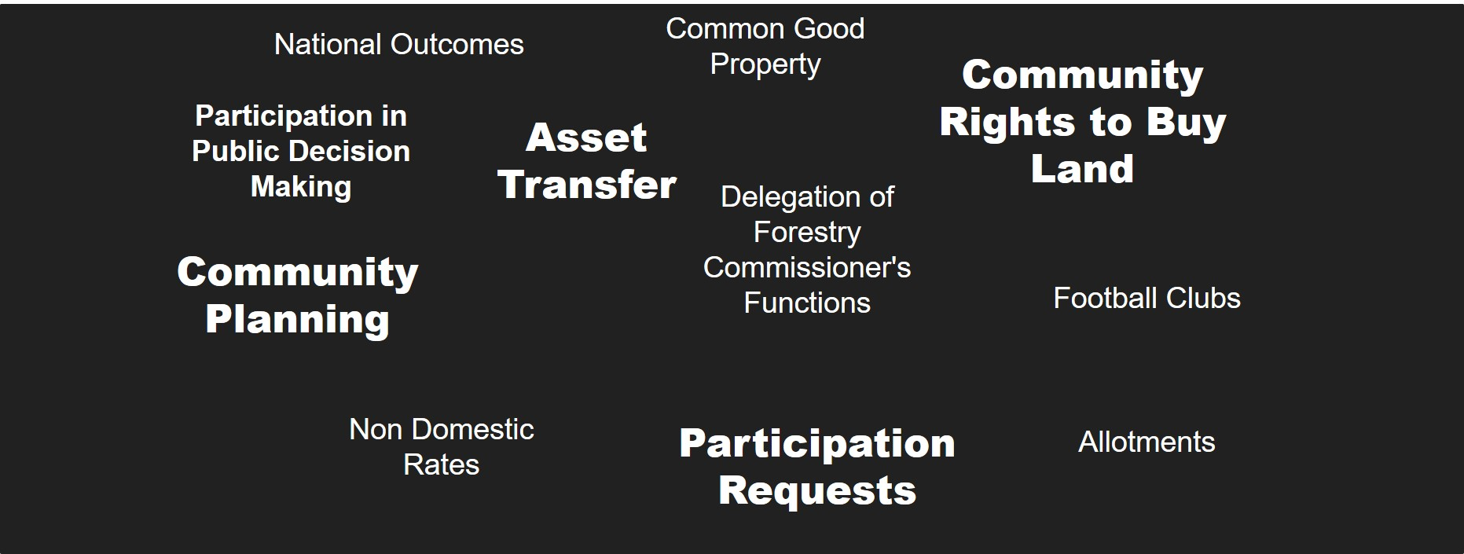
Community Empowerment (Scotland) Act 2015

Slide 3
Participation Requests
Help people start a dialogue about something that matters to people in their community
Help people have their voice heard in policy and service development, through contributing to decision-making processes
Help people to participate in the design, delivery, monitoring or review of service provision, through contributing to service change or improvement
Help people challenge decisions and seek support for alternatives which improve outcomes.

Slide 4
Participation Requests (cont.)
Don’t replace any other ways of engaging with public bodies
Have their pluses and their minuses
Aren’t a complaints system
Are outcome focussed

Slide 5
When submitting a participation request, a community body is required to:
Say what the outcome is that they want to improve
State why they think they should participate
Tell the authority what outcome related knowledge / skills / experience they have
Say what improvement in the outcome they think will happen as a result of their participation

Slide 6
What is the outcome you want to improve?
Example 1: Your group wishes to see an area of waste ground developed for community use.
Q.“What difference will this make to our local community?”
A.“There will be an improved environment, and there will be an increase in physical activity levels”(these are your outcomes)
Example 2: The local community would like an extension of opening hours of a community library.
Q.“What difference will this make to our local community?”
A.“There will be improved access to local community facilities which will help to improve opportunities for learning and reduce social isolation.(these are your outcomes)
Scottish Community Development Centre,
Participation Requests :Summary Guidance for Community Participation Bodies

Slide 7
Who can submit a request?
A Community Controlled Body
A Community Council
A Community Controlled Body without a written constitution
A designated community participation body

Slide 8
Timescales involved
Request is received
30 /45 working days to issue Decision Notice
Decision notice is issued
community has 28 days to respond if they wish to suggest changes to the proposed Outcome Improvement Process
public body has 90 calendar days, from date decision notice is issued, to begin the Outcome Improvement Process

Slide 9
Which public bodies can I submit a Participation Request to?
Local authorities
Health Boards
The board of management of a college of further education
Highlands and Islands Enterprise
National Park Authority
Police Scotland
Scottish Enterprise
The Scottish Environment Protection Agency
The Scottish Fire and Rescue Service
Scottish Natural Heritage
Regional Transport Partnerships
Notes:
Different parts of the Act apply to different public bodies. For example, above are some of the agencies that participation requests apply to. If you want to submit a PR to an HSCP then you would submit it to both authorities with one named as the lead authority and the other as the secondary authority.

Slide 10
How do I find out more?
Participation request - Frequently asked questions | SCDC - We believe communities matter
Find out more about Participation Requests (argyll-bute.gov.uk)
Community empowerment: Participation requests - gov.scot (www.gov.scot)

