Slide 1
Local Place Plans (LPP’s)
22ND NOVEMBER 2024

Slide 2
Local Place Plans –What are they?
Local place plans are a new way for local communities to help shape the places where they live, work and play.
They provide a chance for communities to identify those land uses and buildings which are important to them.
They should be map based
Accompanied by a short statement setting out the communities proposals for the development and use of land.
Notes:
Local Place Plans are part of the Government’s wider work on planning reform and implementation of the Planning (Scotland) Act 2019 (the 2019 Act), including steps to reduce conflict, improve community engagement and build public trust in planning matters.
Local Place Plans are community-led plans setting out proposals for the development and use of land.
Introduced by the 2019 Act, these plans will set out a community’s aspirations for its future development.
Once completed and then registered by the planning authority, they are to be taken into account in the preparation of the relevant local development plan.

Slide 3
Local Place Plans –why prepare
They provide the opportunity for community councils or other community bodies to involve their communities to plan for their future.
how they can make it better, reflect local priorities and to take action to deliver
They can also be used to inform others of opportunities and constraints which the community

Slide 4
Local Place Plans and Local Development Plan 3
Local Place Plans are to be taken into account by the planning authority when preparing LDP.
The provide an opportunity for communities to influence the LDP at an early stage of plan preparation.
Local Place Plans are not compulsory. There are other opportunities for communities to input in to LDP.
In addition to, or in advance of LDP3 there is an opportunity for registered Local Place Plans to be a material consideration in determination of planning applications.
Notes:
The general way of preparing a Local Place Plan will not be fundamentally different from how communities have been preparing community-led plans. However, for a community-led plan to be considered as a Local Place Plan and therefore, once registered, to be taken into account by the planning authority in preparing its Local Development Plan, the Community Body preparing the plan must fulfil a number of legal criteria. (Kim will provide more information on this aspect later on in the presentation)
Opportunity of influence LDP at an early stage, hence our invitation to prepare, and timetable for submission for validation, takes in to account our development plan scheme which sets out the various stages of LDP process.

Slide 5
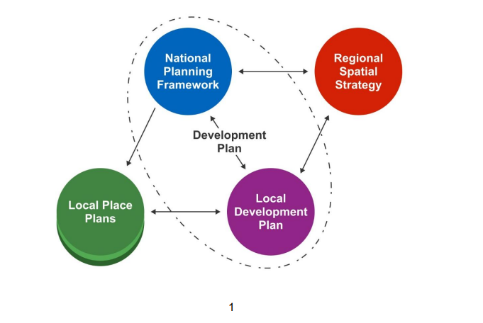
Local Place Plans - Context
Notes:
Local Place Plans require to be considered in the context of the Development Plan, this slide is taken from the Scottish Governments Guidance on Local Development Plans. It shows the SG’s expectations as to how LPPs relate to both the National Planning Framework and the Local Development Plan.

Slide 6
Local Place Plans - Form
Not prescribed – other than should relate to the development or use of land.
They could be prepared for the whole of a community councils area, or just a small part.
They could even be for just a single building, or a particular theme.
Can be prepared by Community Councils or any other “Community Body”
Dev Plan team would encourage collaborative working.
Notes:
DP support community councils to take lead in LPP process. Their role as representative of communities established. Community bodies will need to provide evidence to show they are properly constituted.
The regulations do not prevent more than one local place plan being prepared for an area. There is no guidance to planning authorities as to what weight should be given to competing plans in this scenario.

Slide 7
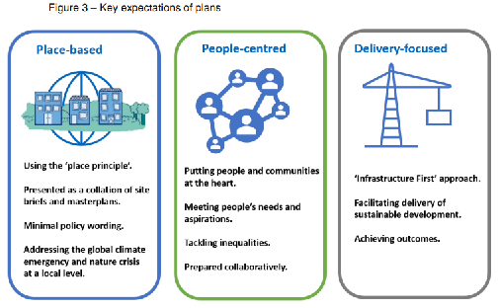
Local Place Plans - Themes
Local Development Plan guidance.
Provides Context in which Local Place Plans can be taken in to consideration .
Notes:
Place based – use place principle, use a map base to show the areas where you have specific proposals, minimal policy wording, reflect climate emergency and nature crisis at a local level.
People centred, meeting peoples needs and aspirations, tackle inequality, prepared collaboratively.
Delieverable

Slide 8
Local Place Plans - Timescale
LPP invitation - June 2024
Evidence gathering for Evidence Report – Dec 2024
Evidence Report - September 2025
Gatecheck – Dec 2025
Propose Plan Preparation throughout 2026
Statutory Consultation on Proposed Plan April-June 2027
Examination 2028
Adoption 2029
Notes:
This slide provides an overview of the LDP timetable. I will provide a bit more detail on these stages and outline where LPP might fit into this process. Explain why we have indicated 30 June 2025 as deadline for validation.
Kim will now provide a bit more detail on how you might look at the various stages in LPP preparation

Slide 9
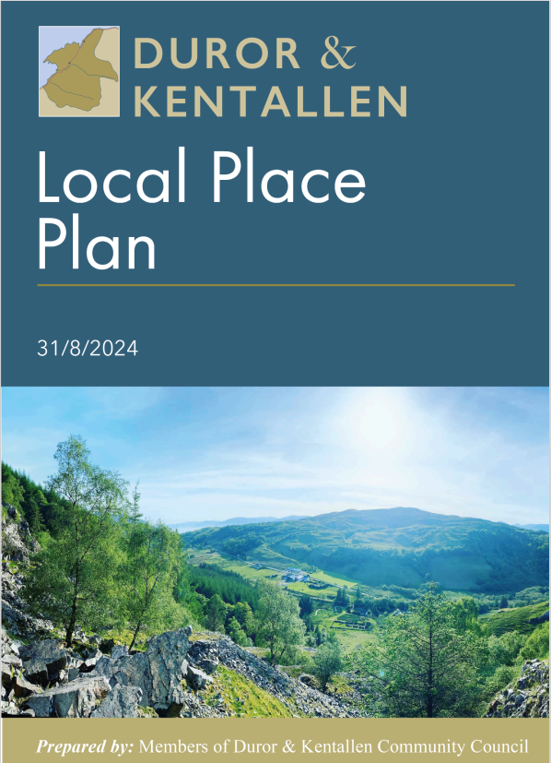
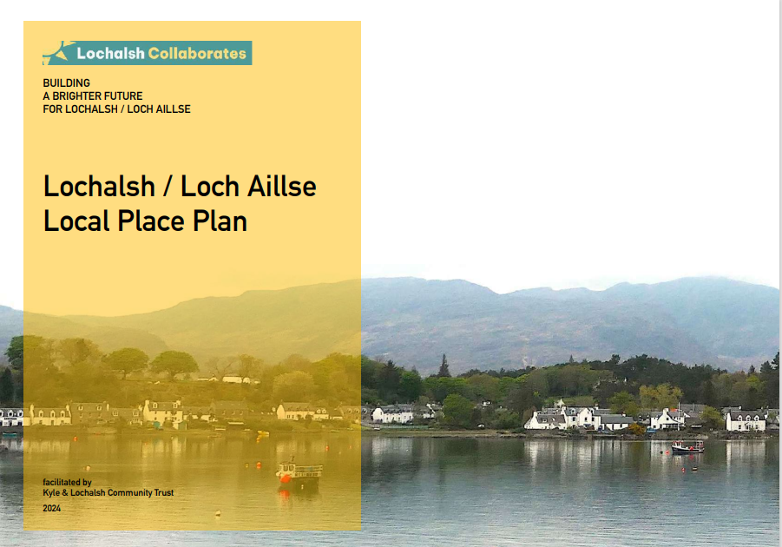
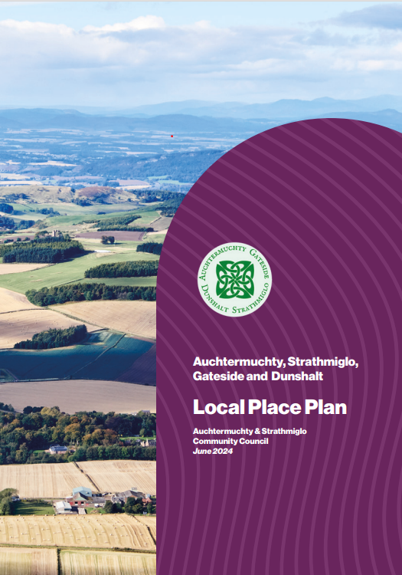
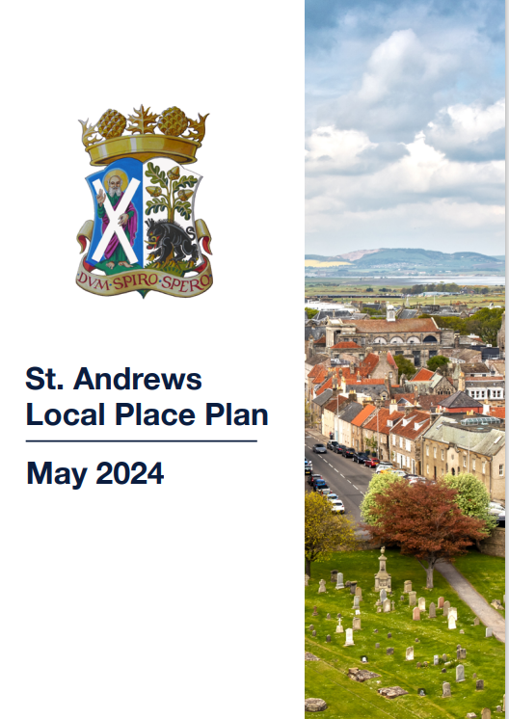


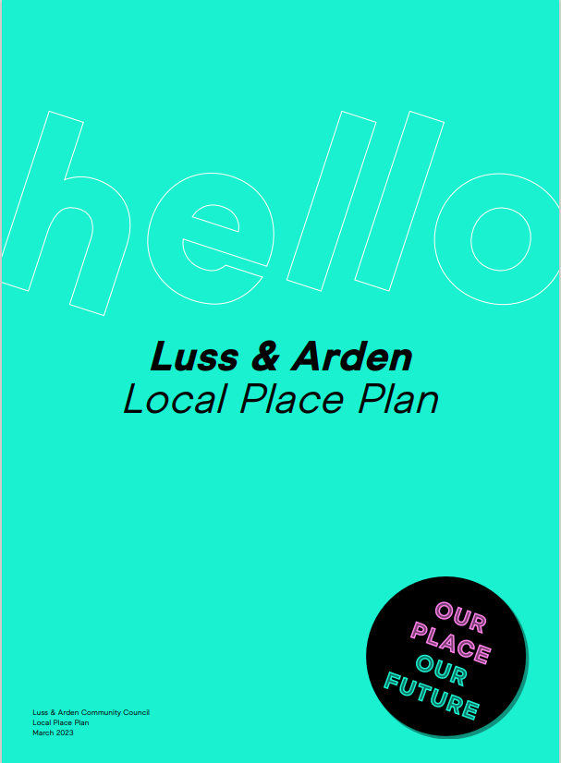
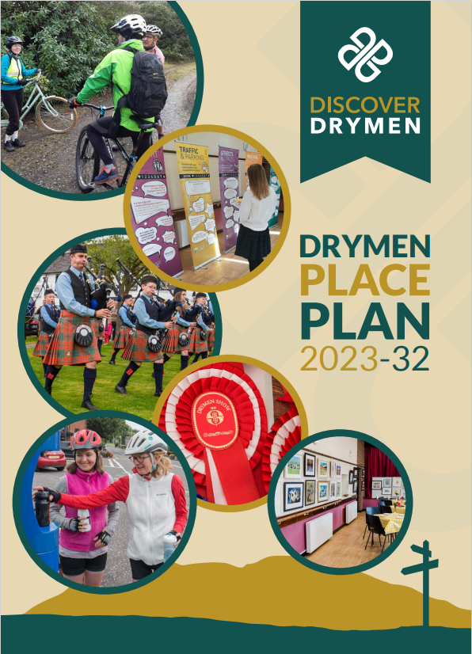
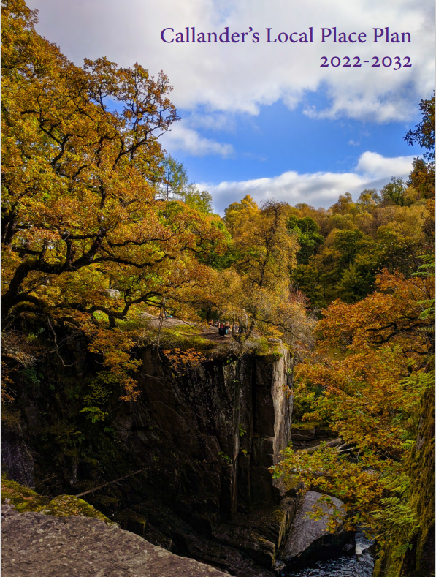
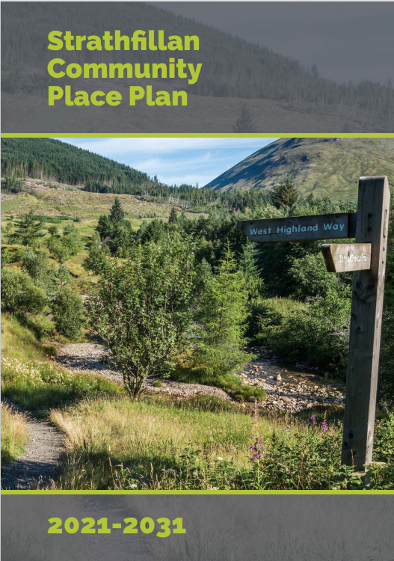
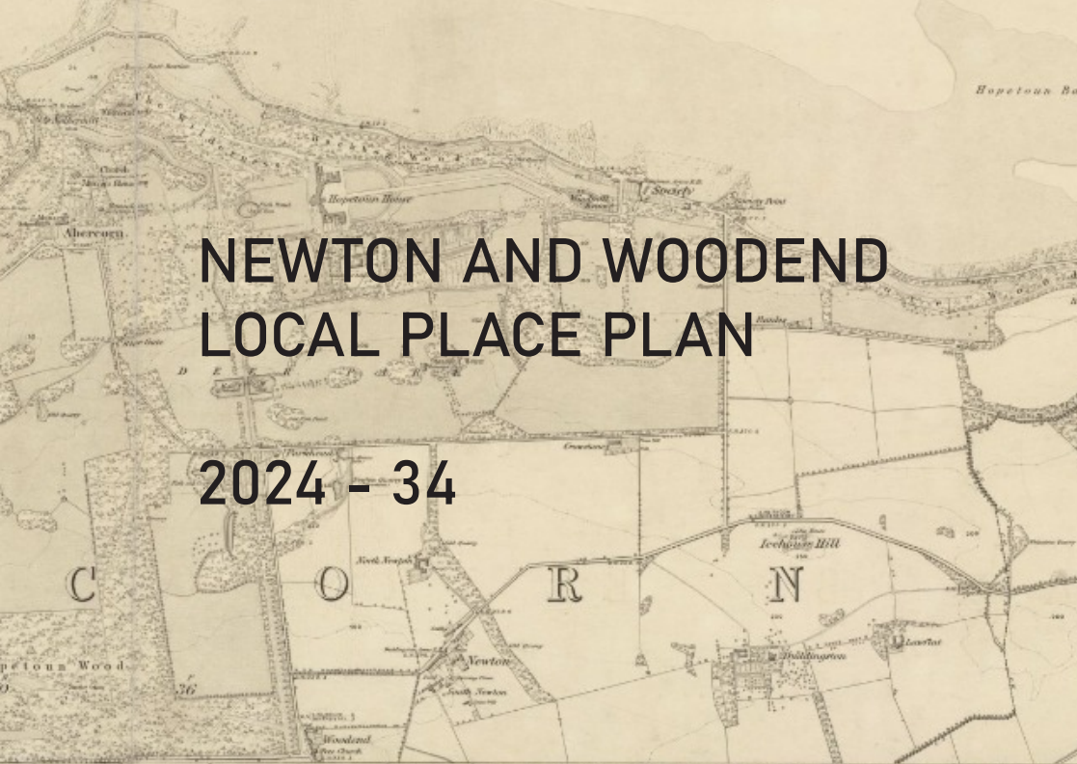
Example LPP’s
Notes:
Hi. My name is Kim de Buiteleir and I’m Acting Senior Planning and Strategies Officer within the Local Development Plan team. I’m going to go over some information that will hopefully help you, within your community, prepare a Local Place Plan.
Firstly I’d like to refer to Local Place Plans that have already been registered across Scotland and point out the variations between these plans, as I’m aware that some of you may have concerns about the scale of the task you are undertaking, and may be worried about the resources required to do this.

Slide 10
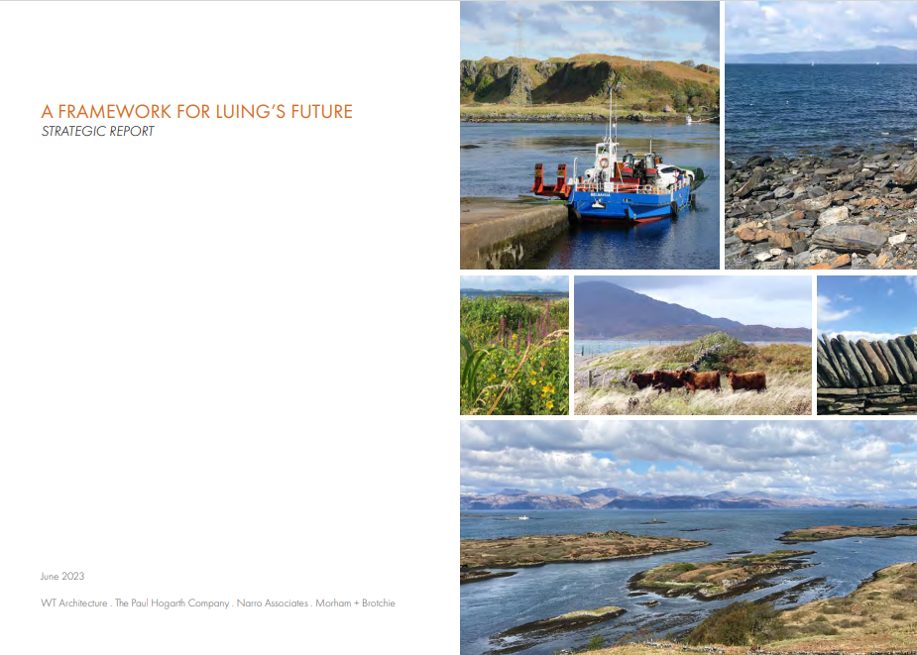
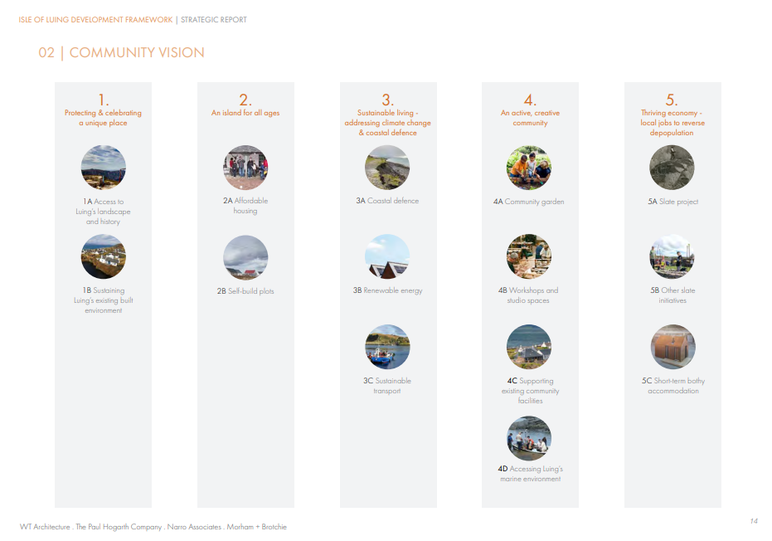
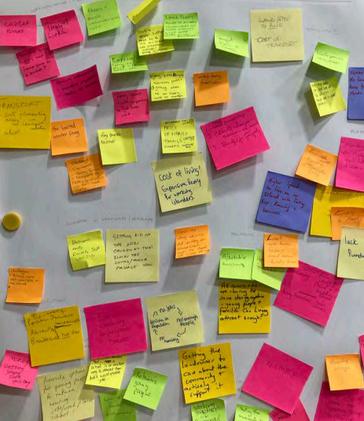
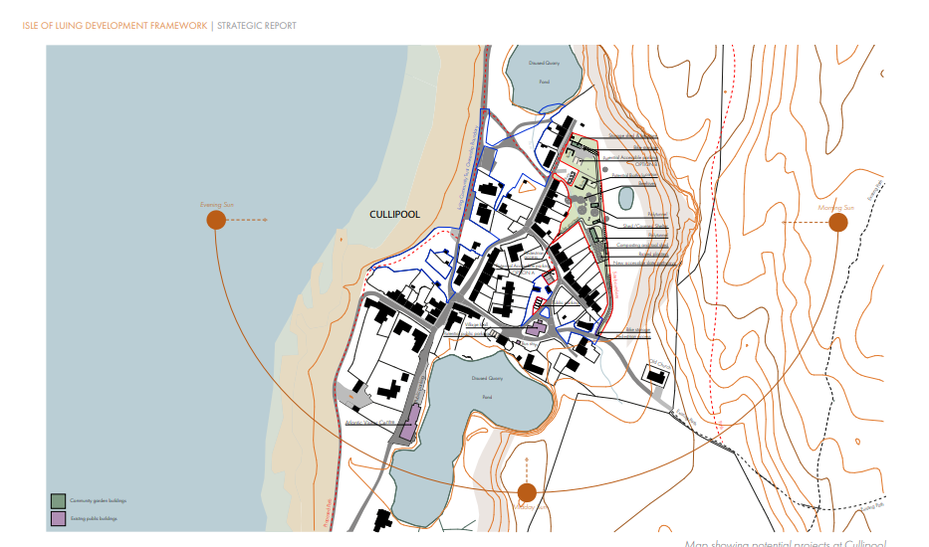
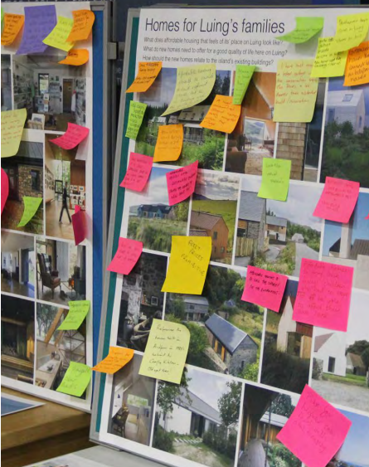
Example LPP - Luing
Notes:
Within the Argyll and Bute planning authority area (our planning area excludes that area of Argyll and Bute covered by the Loch Lomond and Trossachs National Park). We have just registered our first Local Place Plan – this has been carried out by Luing Community Trust, and a report has been prepared for the Planning, Protective Services and Licensing Committee to inform them that this Local Place Plan is being registered.
Luing’s Local Place Plan is available on our website now. This is a very large document which was carried out by external consultants. It’s the culmination of a lot of hard work and is a very comprehensive, detailed, impressive document, however

Slide 11

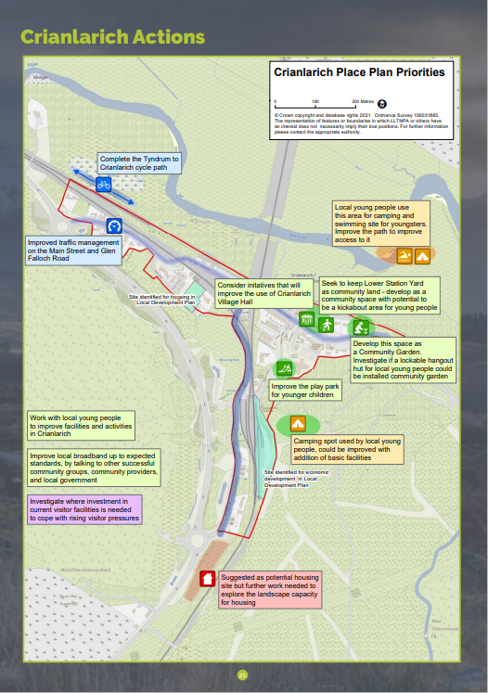
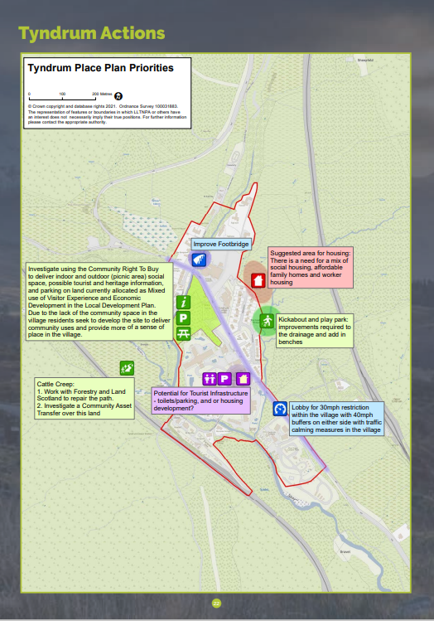
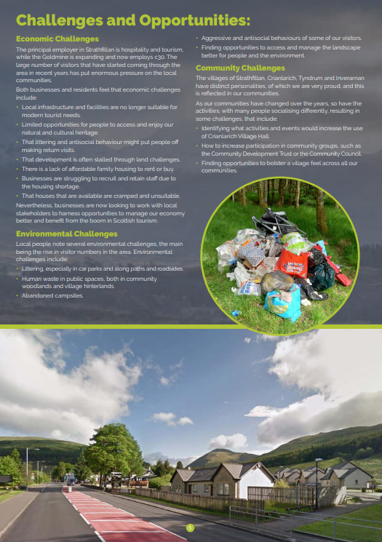
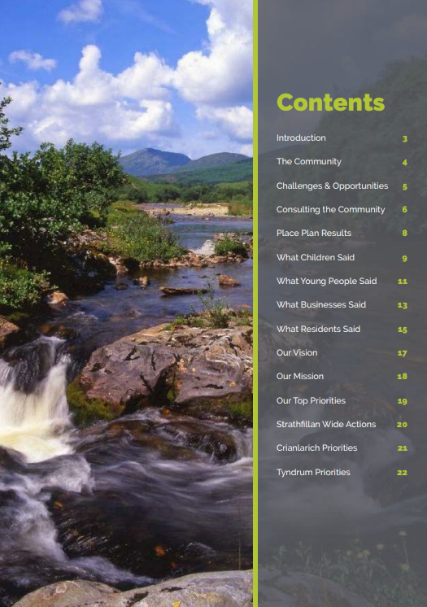
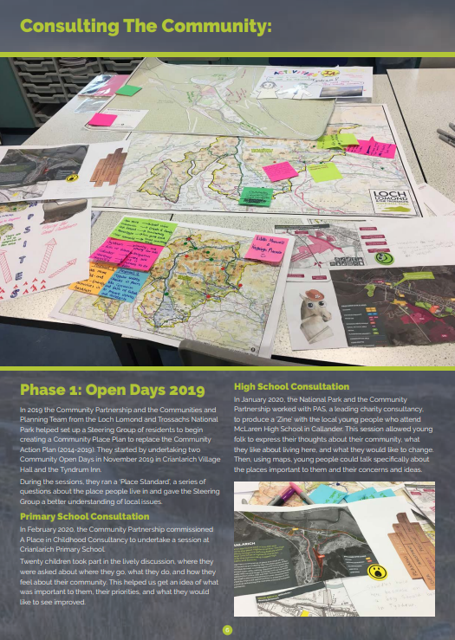
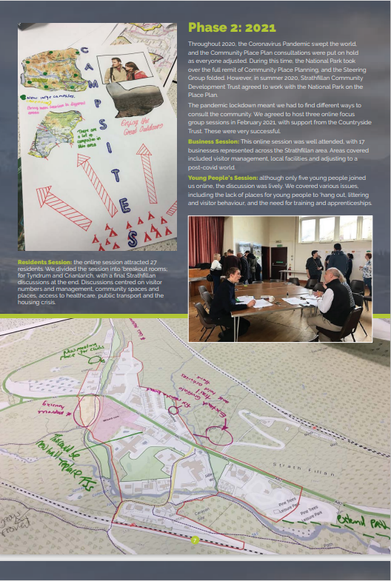
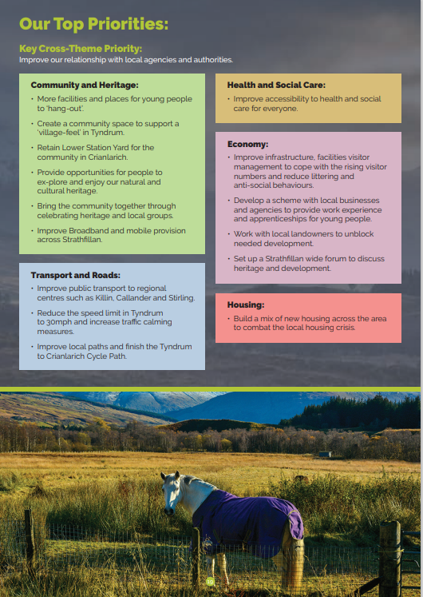
Example LPP - Strathfillan
Notes:
To reassure you that a Local Place Plan does not NEED to be so complex or detailed, I would suggest having a look at the Register for Local Place Plans on Loch Lomond and Trossachs National Park’s website – in particular Strathfillan’s Place Plan which is only 24 pages long but sums up key points including:
The required map of the area
Who the community is
Economic, environmental and community challenges
Engagement – including schools, and the results of this engagement including identification of priorities for young people, businesses and residents
Sum up of Vision, Mission and overall Priorities
Key actions for each town or village
So, what I’m saying is that there is no right or wrong length, or level of detail and complexity. But given the limited time remaining in order to integrate with our LDP3 it’s well worth looking at how you as communities can keep the process as simple as possible in order to meet the statutory requirements and also which results in a meaningful document. The focus on engagement in Strathfillan’s Local Place Plan, and how it is broken down into groups, sets out simply and clearly the priorities within the community in relation to development and land-use, and this is, after all, the purpose of a Local Place Plan.
I picked Strathfillan as an example simply because of its geographic proximity to our planning authority, but there are lots of other great examples out there. The National Park currently has 11 LPP’s on their register so it’s well worth a look at some of these. But also, as I mentioned, on our own website we now have Luing’s which is worth a look at, but is perhaps more complex than you wish to carry out given the resources you might have.

Slide 12
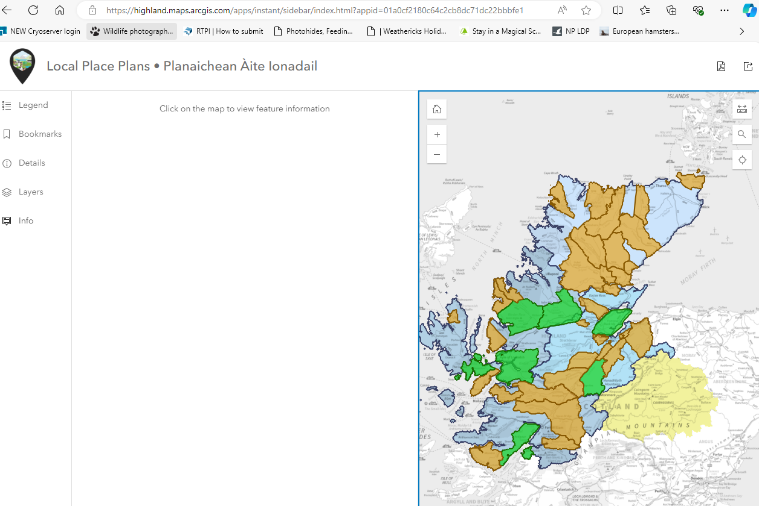
Highland Council LPP’s
Notes:
Another neighbouring local authority which has a number of Local Place Plans already registered is Highland Council so again I’d advise having a look at some of these. I’ve included on the screen their map where you can see the green areas are where LPP’s have been registered, and the orange areas and areas where the planning authority have been notified of the community’s interest or intention to carry out a Local Place Plan. Once we get further into the process in Argyll and Bute, we will have a similar sort of interactive map on our website.

Slide 13
Community Bodies
A community-controlled body within the definition given in Section 19 of the Community Empowerment (Scotland) Act 2015, or
(b) A community council established in accordance with Part 4 of the Local Government (Scotland) Act 1973
Notes:
before you actually get started on preparation of your LPP, let’s check who can prepare one of these documents.
A Local Place Plan can be prepared by a “community body” which must fulfil a number of legal criteria. This can be a community council (established in accordance with the provisions of the Local Government (Scotland) Act), or a community-controlled body within the definition given in section 19 of the Community Empowerment (Scotland) Act 2015, the latter must have a written constitution.

Slide 14
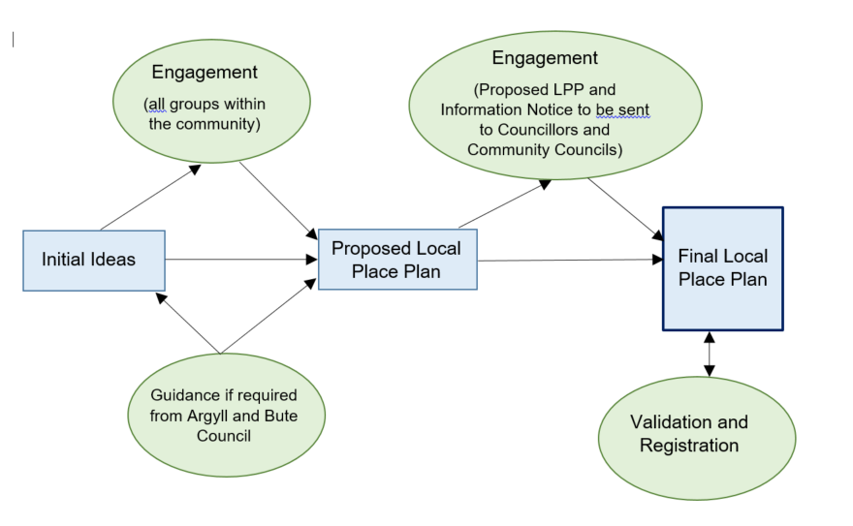
Preparation Flow Chart
Notes:
I have put up on screen here a flow chart which should clarify the preparation stages of a Local place Plan, from the draft to proposed, finalised, validated and registered
So the band along the middle is the work undertaken by the community council or other community body. The top is the engagement and consultation required with the wider community, relevant councillors, and community councils within or adjoining the area. And the bottom line shows where there may or will be liaison with the Argyll and Bute planning authority.
The first step will be to develop initial proposals in collaboration with the wider community. This will involve identifying key areas of concern and priorities (related to development and land use). You can tackle this by breaking down the priorities into, for example, economic, environmental and social priorities. And a really nice way that Strathfillan did theirs was to consider key groups of: youth, businesses and residents separately, so that the priorities of each group could be clearly put forward and understood.
Records should be kept of all engagement.
Then a Proposed Local Place Plan can be drawn up. This must be sent, along with the Information Notice, to each Councillor for the Local Place Plan area, as well as any community council any part of whose area is within, or adjoins, the Local Place Plan area. A period of at least 28 days must be allowed for representations to be made.
Once the Local Place Plan has been finalised, this and the Information Notice and Validation Checklist should be submitted to the planning authority. Validation does not involve us checking the content of the Local Place Plan, but is simply checking that the legal requirements have been met. Once this has been done we will then be able to register the Local Place Plan and notify the Planning Committee (PPSL) that this has been registered, and we will put it on our website.

Slide 15
Key Information
Once registered, LPP’s will be taken into account in the preparation of the next Local Development Plan (LDP3). In order to help fully inform the LDP3, LPP’s should be received by 30th June 2025 ahead of us finalising our Evidence Report.
Submission:
Validation Checklist
Information Notice
Local Place Plan
Notes:
So, you’re aware of the timescale of the end of June 25 we set in order to be FULLY taken into account in our Evidence Report (which is an early stage document in the preparation of LDP3). You will know that there is a minimum 28 day consultation period for representations. So that lets you work out your timeline for preparation.
That deadline however does assume that we will be able to validate and register the LPP promptly. For that to happen it is absolutely essential that the information submitted meets the statutory requirements. There is a Validation Checklist on our website – this should be used right from the start of the process to keep you on track with the requirements. The submission must include the completed Validation Checklist, the LPP and also an Information Notice including:
A brief description of the content and purpose of the proposed LPP,
Information as to how and to whom any representations on the content of the proposed local place plan should be made and the date by which they should be made.

Slide 16
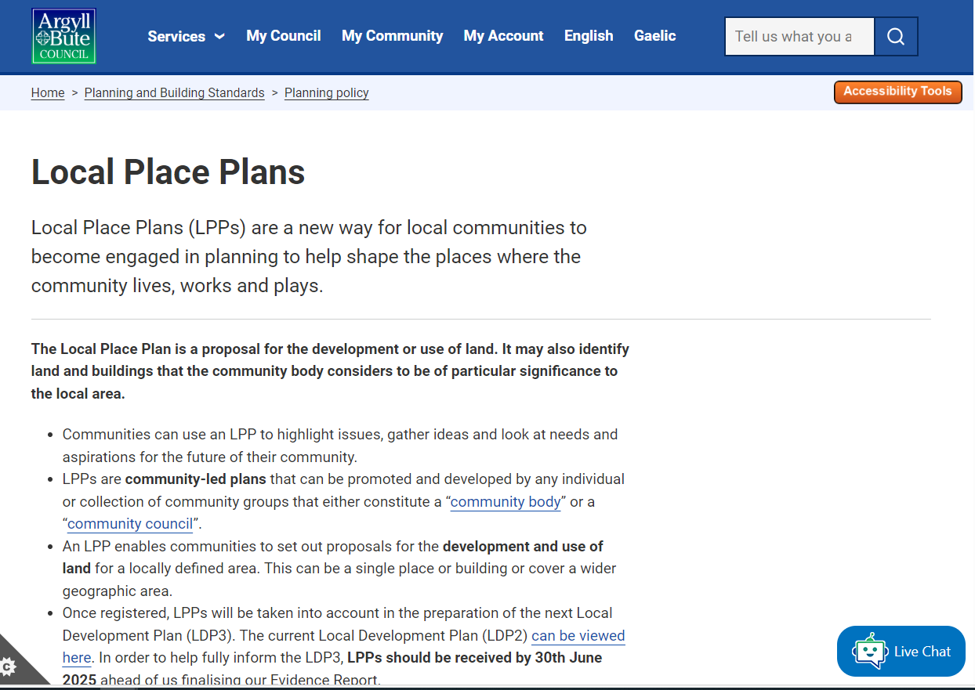
Webpage
Notes:
As you will appreciate, we unfortunately have limited resources so we are unable to provide in depth individual support for each community. So what we have done, to try to make the process as straightforward as possible, is included a number of key resources on our website and I will take you through this now:
The webpage can be found by navigating from the Home Page, to Planning and Building Standards, to Planning Policy and then to Local Place Plans. Alternatively it can be found by googling Argyll and Bute Council Local Place Plans. I have put a link on the screen however depending on the format of the recording this may or may not work.
So firstly, the web page explains what Local Place Plans are and there are 2 key messages here:

Slide 17
Webpage
Notes:
The first is that these are a way for local communities to become more engaged in planning and help shape the places where the community lives, works and plays. And this is a really positive thing.
Secondly though, we do clarify the limitations of Local Place Plan, and that is that it is a proposal for the development or use of land (and it may also identify land and buildings that the community considers t o be of particular significance to the local area).

Slide 18
Webpage
Notes:
I mentioned earlier the requirements in terms of being a community body or community council – there are hyperlinks to the relevant legislation from each of these terms so if in doubt, you can check if your body meets the requirements.

Slide 19
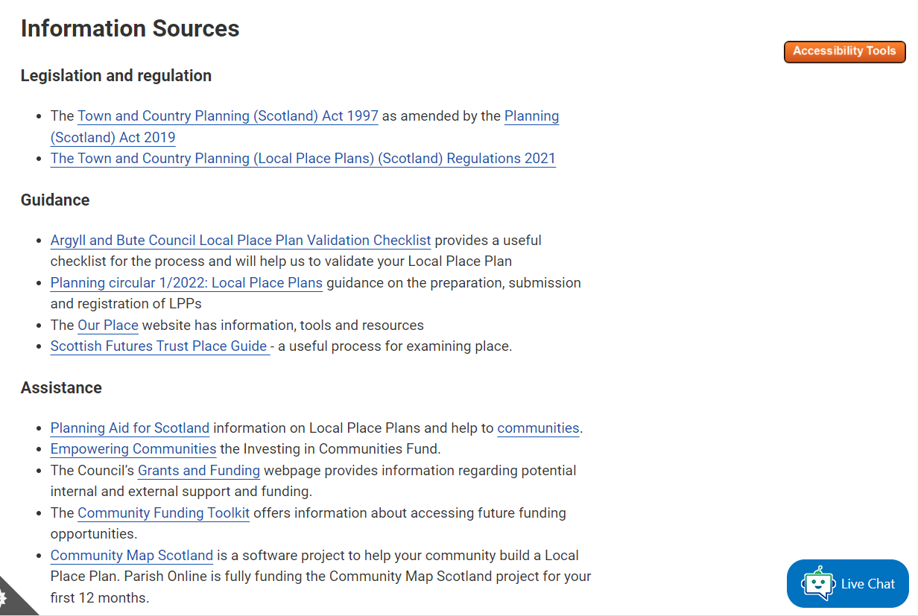
Webpage
Notes:
The web page includes the legislation governing the preparation of Local Place Plans. The Local Place Plan Regulations are actually fairly short and straightforward, so they are not too daunting. However, within the Guidance section below that, we have included a link to Planning Circular 1/2022 – this covers the information in the legislation in a clearer, easier to understand, way.

Slide 20
Webpage
Notes:
And the other key piece of guidance is our Validation Checklist. I mentioned this earlier, and it’s really essential that you use this from the outset to ensure that the Local Place Plan that you put together, and that you submit for validation and registration, is actually valid.
Once we have registered our first Local Place Plan over the next few week, this will be available from this webpage, along with a map showing where Local Place Plans have been registered.

Slide 21
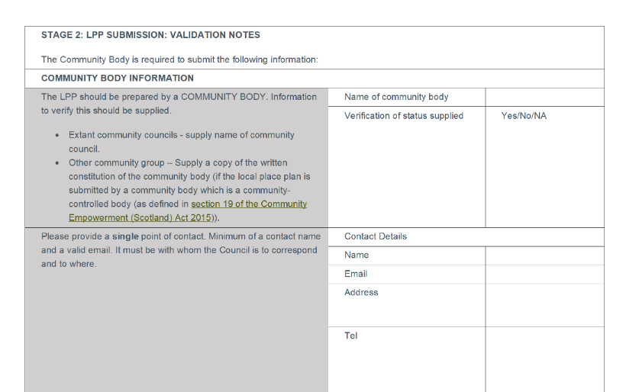
Validation Checklist
Notes:
I’ll talk through the validation checklist in a bit more detail.
I’m going to start with Stage 2 of the checklist which is the validation notes, which you should read through and start to complete from a very early stage.
So, Community Body information – the name of your community body, and do you have verification of your status. The latter is not required if you are a community council. But if you are another community group, we need a copy of the written constitution of your group.
And regardless of whether you are a community council or another community group, you need to provide contact details for a single point of contact – the minimum requirement for this is a contact name and valid email address.
Then there is a checklist for what must be within the content of your local place plan:

Slide 22
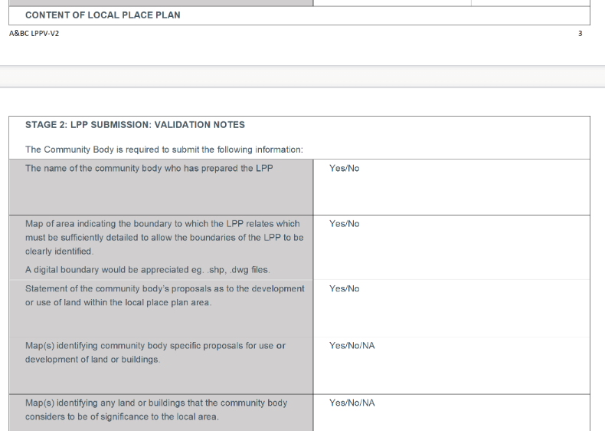
Validation Checklist
Notes:
The name of the community body who has prepared the local place plan;
A MAP of the area showing the boundary to which the Local place plan relates – and in addition, provision of a digital boundary to us would be much appreciated. There was an earlier webinar session on mapping which hopefully some of you attended to get more information on this.
Also, a STATEMENT of the community body’s proposals as to the development or use of land within the Local Place Plan area;
MAPS identifying any specific proposals for use or development; and the maps should also identify any land or buildings which the community considers to be significant to the local area.

Slide 23
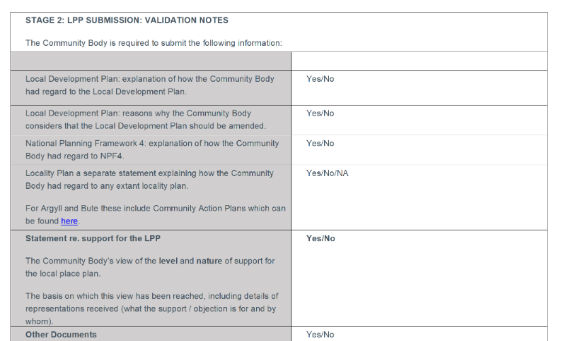
Validation Checklist
Notes:
SEPARATE to, but accompanying, the local place plan, we need a statement regarding consideration of other statutory plans. So the Development Plan comprises NPF4 (a national planning document) and LDP2 (Argyll and Bute’s 2nd local development plan).
This also needs to include if, and reasons why, the community thinks that the Local Development Plan should be amended.
A further statement is required setting out the community body’s view on the level and nature of support for the local place plan including the basis on which this view has been reached, and representations made. This is why it is key to ensure that your engagement reaches a variety of groups, incorporating people across the whole community. And I used the Strathfillan LPP earlier as a great example of how they had broken engagement down into groups of Youth, Businesses and residents, to meet this need here.
A statement should also set out how the LPP has taken any Community Action Plans into account.

Slide 24
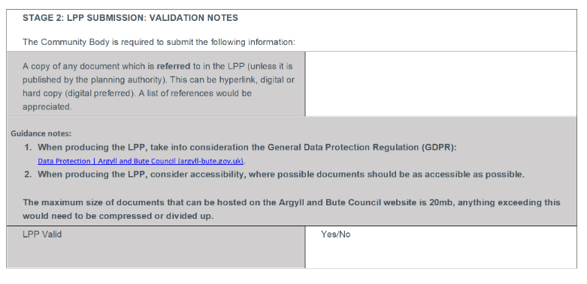
Validation Checklist
Notes:
Also, if any document is referred to in the Local Place Plan (other than those published by the planning authority) then a copy must be provided to us.
Guidance notes on the Local Place Plan:
Consider the General Data Protection Regulations (and there is a link within the validation checklist to this)
And consider ACCESSIBILITY of the document, as well as its SIZE

Slide 25
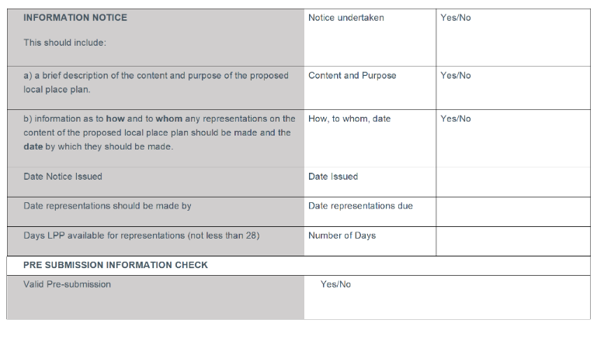
Validation Checklist
Notes:
Returning now to Stage 1 of the Validation Form: as I mentioned earlier the Information Notice must include:
A Brief description of the content and purpose of the proposed local place plan, and
Information as to HOW and to WHOM representations on the LPP should be made, and the date by which they should be made (and a period of at least 28 days is required for representations).

Slide 26
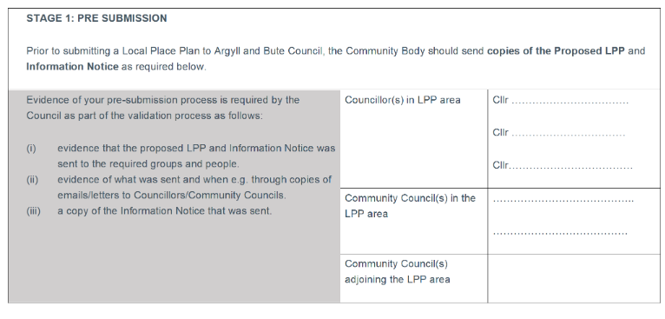
Validation Checklist
Notes:
We need to see EVIDENCE that the proposed LPP and Information Notice was sent to the required groups of people, which are Councillors and Community Councils, and these must be listed within the validation checklist.

Slide 27

Contact Details
Notes:
So, I mentioned earlier that we as a planning authority, unfortunately cannot offer the level of support that some communities may be hoping for.
However we can provide some degree of ongoing support via email for example if you needed assistance identifying all the councillors who you need to contact, or if you want to check something in terms of the other plans that you need to have regard to in the preparation of your LPP, or other general questions in terms of legislative requirements etc.
Additionally we hope this webinar today does provide meaningful support to you to help communities feel more assured and confident about what you are undertaking.
Thank you

